Slide 1
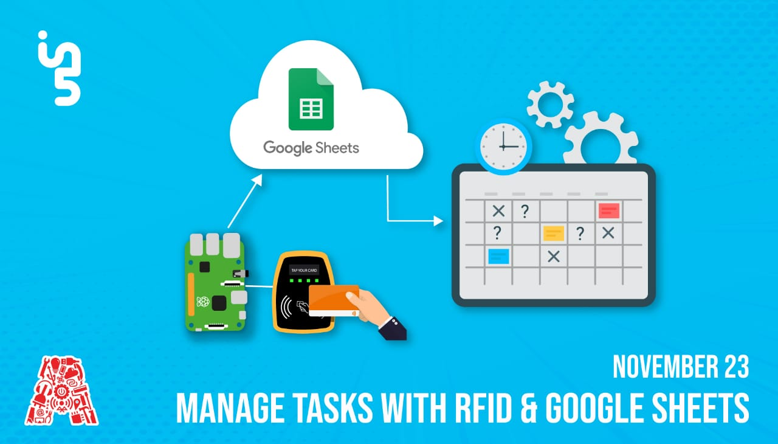

Slide 2
About the Assembly
A smart lab based out of In5 since Dec 2014
Over 250 free workshops done
ASSEMBLY: HACK - Embedded systems, iOT and hardware
ASSEMBLY: CODE - Software projects - APIs, frameworks, apps
Age range: 16-60 - students, professionals, entrepreneurs
Focus on smart technology and practical applications
Forum: members.theassembly.ae

Slide 3
TAG US ON OUR SOCIAL MEDIA
FACEBOOK
TWITTER
INSTAGRAM
YOUTUBE
The Assembly (@MakeSmartThings)
@MakeSmartThings
@MakeSmartThings
The Assembly

Slide 4

Overview
TOPICS:
Background of RFID
Real-Life Implementations
Components
Circuit Breakdown
Code Explanation

Slide 5

Introduction to RFID
Radio-Frequency Identification
Radio-frequency identification (RFID) uses electromagnetic fields to automatically identify and track tags attached to objects.
The tags contain electronically stored information. Passive tags collect energy from a nearby RFID reader's interrogating radio waves.
Mac OS 10.14

Slide 6
Advantages and Disadvantages of RFID
Advantages | Disadvantages
High Speed | Interferance
Multipurpose and many format | High Cost
High Accuracy | Overhead reading (fail to read)
Mac OS 10.14

Slide 7
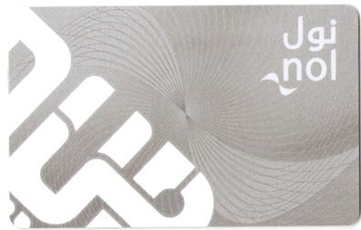
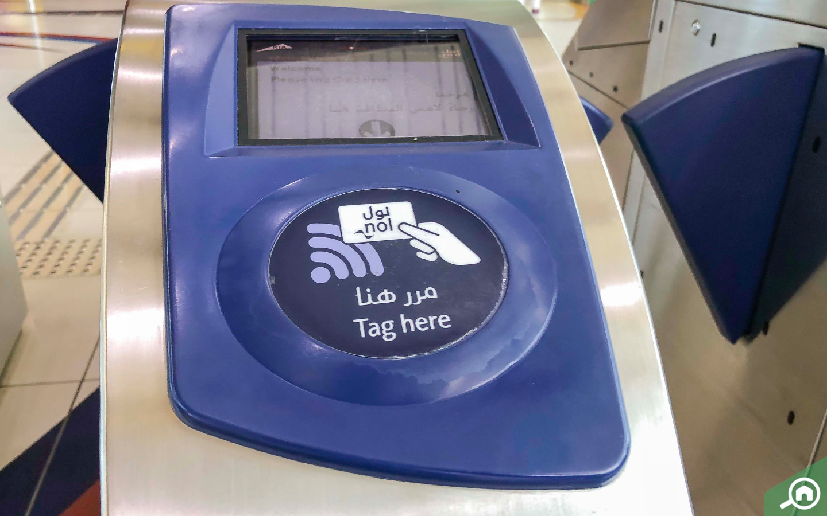
Real-Life Implementation of RFID
Mac OS 10.14

Slide 8


Dependencies
Download the files from GitHub
https://github.com/The-Assembly/Manage_Tasks_RFID
Download VNC Viewer to access the Raspberry Pi
https://www.realvnc.com/en/connect/download/viewer/

Slide 9
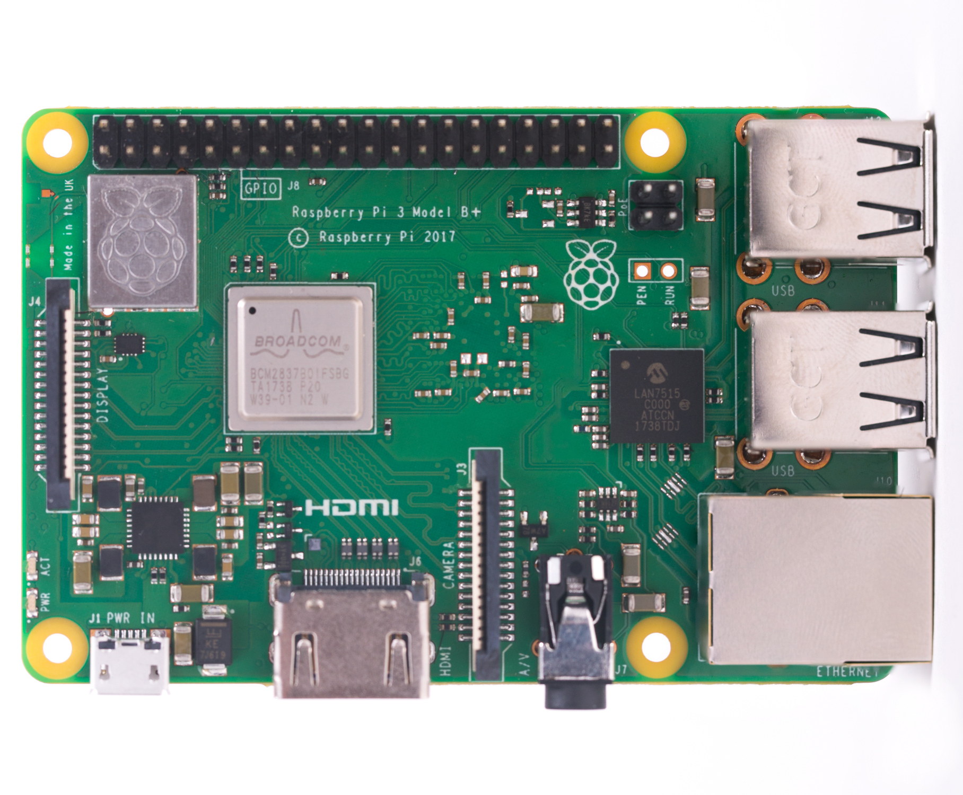
Components
Raspberry Pi
SoC: Broadcom BCM2837B0 quad-core A53 (ARMv8) 64-bit @ 1.4GHz
GPU: Broadcom VideoCore-IV
RAM: 1GB LPDDR2 SDRAM
Networking: Gigabit Ethernet (via USB channel), 2.4GHz and 5GHz 802.11b/g/n/ac Wi-Fi
Bluetooth: Bluetooth 4.2, Bluetooth Low Energy (BLE)
Storage: Micro-SD
GPIO: 40-pin GPIO header, populated
Ports: HDMI, 3.5mm analogue audio-video jack, 4x USB 2.0, Ethernet, Camera Serial Interface (CSI), Display Serial Interface (DSI)
Dimensions: 82mm x 56mm x 19.5mm, 50g
Mac OS 10.14

Slide 10
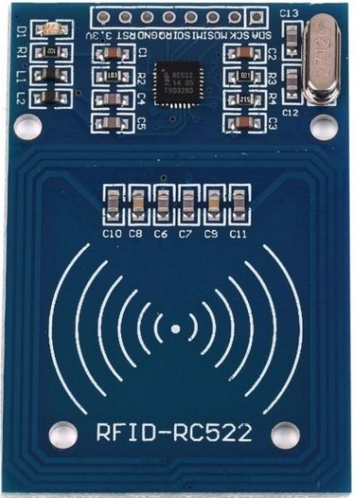
Components
RC522 – RFID Reader/Writer
Operating Current :13-26mA / DC 3.3V
Idle Current :10-13mA / DC 3.3V
Sleep Current: < 80uA
Peak Current: < 30mA
Operating Frequency: 13.56MHz

Slide 11
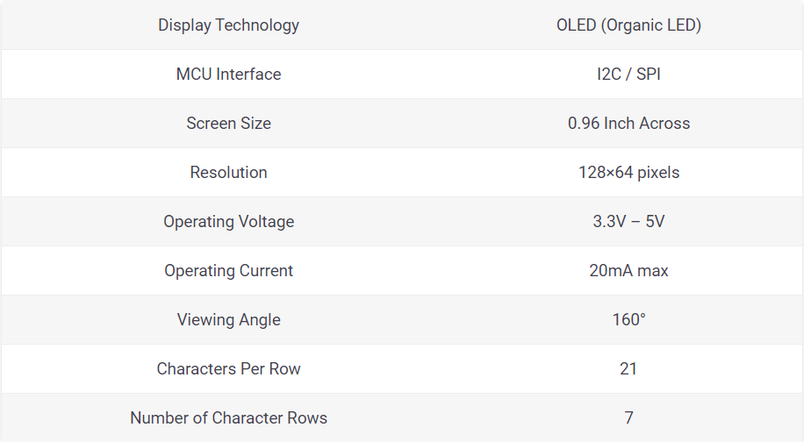
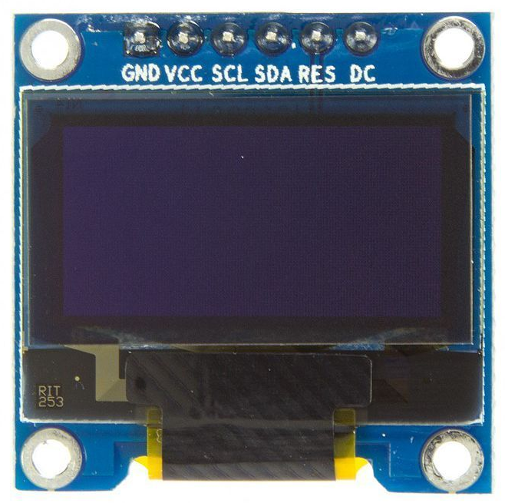
Components
OLED Screen
Mac OS 10.14

Slide 12
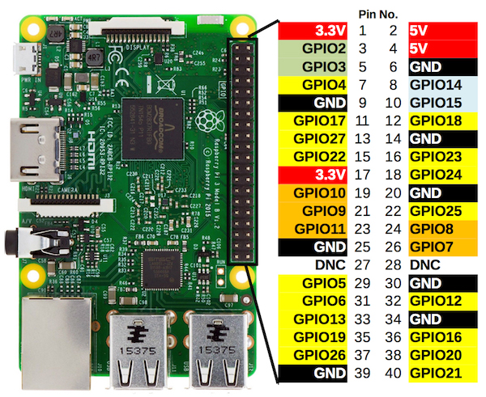
Introduction to Raspberry Pi
26 GPIOs @ 3.3V Output
2 5V Pins
2 3.3V Pins
8 GND Pins

Slide 13
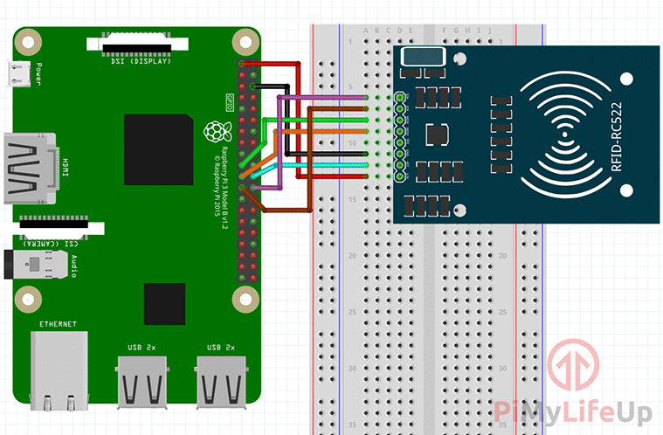
RFID - Circuit
Mac OS 10.14

Slide 14
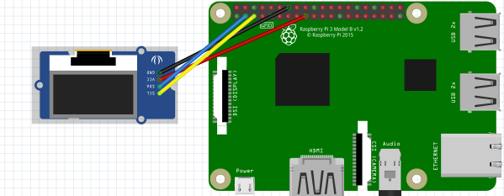
OLED- Circuit
Mac OS 10.14

Slide 15
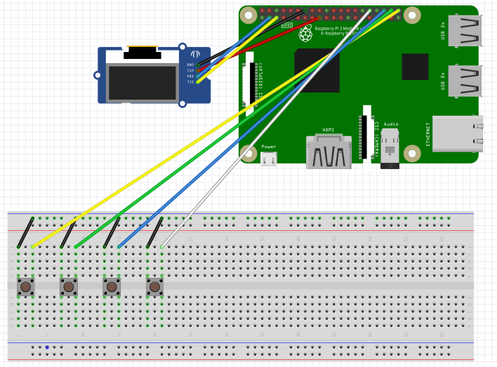
Buttons- Circuit
Mac OS 10.14

Slide 16
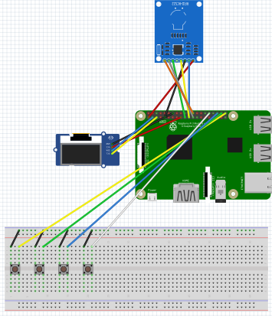
Integrated Circuit
Mac OS 10.14

Slide 17

Google Sheets
Go to the Google Drive.
Create a new Sheets file.
Mac OS 10.14

Slide 18
Google Sheets
Steps to Enable and Activate the API
Go to the Google API’s Console - https://console.developers.google.com/
Create new project.
Click Enable API. Search for Drive API and Sheets API.
Create Credentials for a Web Server to access Application Data.
Name the Service account and grant it a Project Role of Editor.
Download the JSON File.
Copy the file to the directory and rename it to client_secret.json
Mac OS 10.14

Slide 19
Google Sheets
Steps to Enable and Activate the API
Next, open the client_secret.json and take the client email.
Open your sheets file.
Click the share button, and share the file with the client email.
Mac OS 10.14

Slide 20
THANK YOU!

